Slide 1

AI-Powered
GitHub Issue Assistant
Turning Chaos into Actionable Insights
Seedling Labs Engineering Intern Craft Case

Slide 2

The Problem: Notification Fatigue
High-velocity engineering teams are drowning in GitHub issues.
Manual triage kills productivity. Developers waste hours switching contexts to read logs, assess impact, and draft replies.
We need a way to cut through the noise.

Slide 3

From Passive Analysis
to Agentic Assistance
A tool that doesn't just summarize, but understands context, assesses business impact, and takes the first step towards resolution.

Slide 4






Core Philosophy: Agentic Thinking
Intelligent Triage
Active Action
Robust Engineering
Moves beyond simple summaries. Uses a "Product Manager" persona to determine if a bug is truly critical or just noise.
Doesn't stop at analysis. Generates professional draft responses to close the loop immediately.
Built with caching, error handling, and strict type validation to ensure production-grade reliability.

Slide 5

Architecture: Modular Monolith
Designed for Seedling's PDaaS model: balancing separation of concerns with rapid deployment.
Frontend: React + Vite + Tailwind (Snappy UI)
Backend: FastAPI + Pydantic (Validation)
AI Core: Google Gemini 2.0 Flash (1M Context)
Ops: Docker Compose for < 5 min setup

Slide 6

Agentic Workflow
1. Ingest
2. Persona
3. Validate
4. Act
Fetch Issue Title, Body & Comments via GitHub API
Apply "Senior PM" Persona with Few-Shot Examples
Enforce strict JSON schema via Pydantic
Generate Priority Score & Draft Response

Slide 7

Going the Extra Mile
Smart Caching: In-memory caching reduces API costs and latency for repeated views.
Confidence Score: Visual indicator (0-100%) warns users if the AI is hallucinating.
Why these matter?
They shift the tool from a "Toy Script" to a "Product". They demonstrate empathy for the user's workflow and budget.
Draft Response: Pre-writes a polite, context-aware reply to the maintainer.
One-Click Export: Formatted output ready for Slack, Jira, or direct clipboard copy.

Slide 8
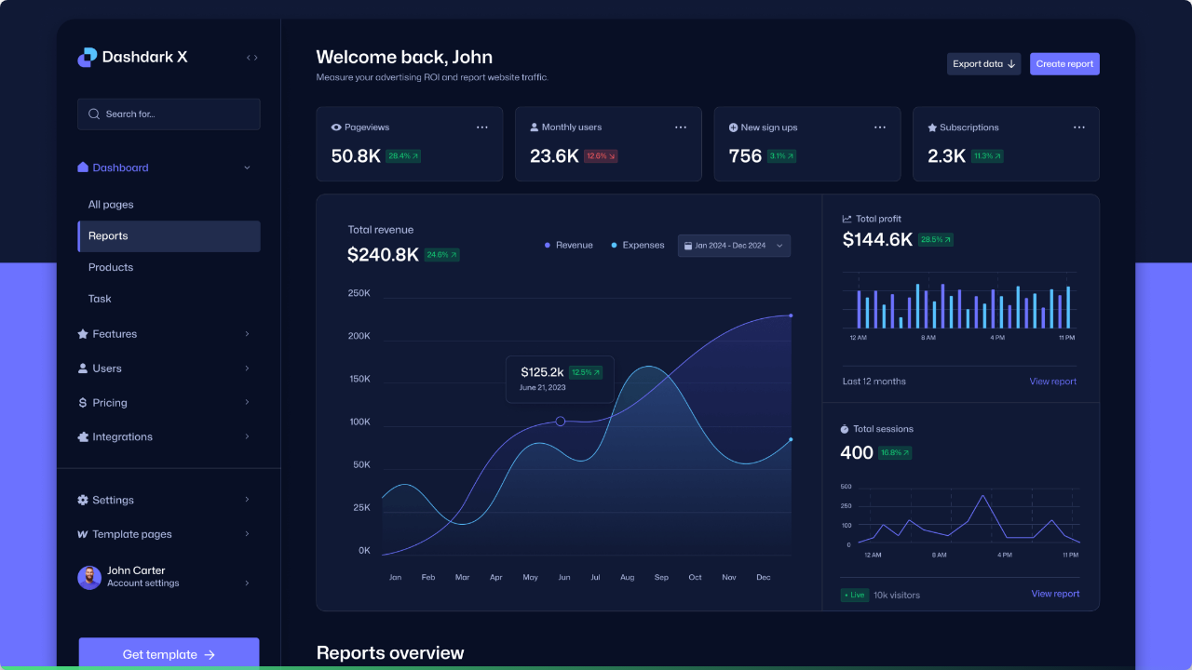
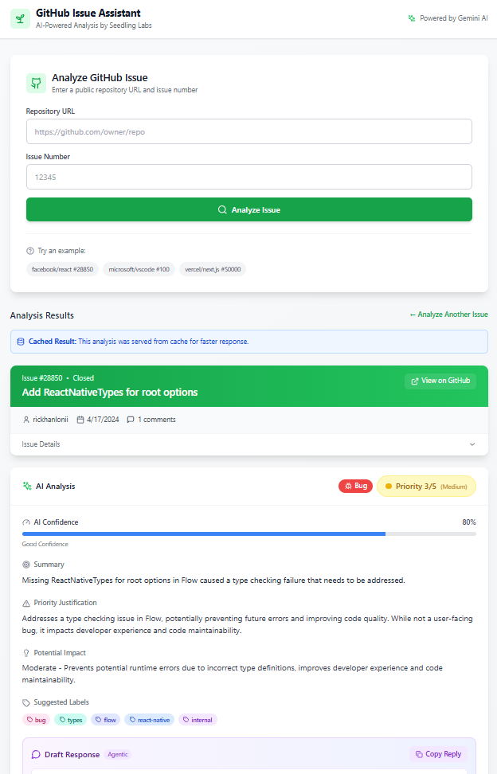

Live Demo
Experience the Agentic Workflow in Action
https://seedlinglabs-ai-github-issue-assistant.vercel.app

Slide 9
Performance Impact
< 3s
Average Analysis Time
Thanks to Google Gemini 2.0 Flash and intelligent caching, insights are delivered near-instantly, keeping developers in their flow state.

Slide 10
Sprouting Further: Roadmap
Phase 2: RAG Integration
Phase 1: Batch Analysis
Connect to the codebase via RAG (Retrieval Augmented Generation) to suggest actual code fixes alongside the text summary.
Analyze an entire repository at once to identify "hot spots" or neglected legacy bugs using bulk processing.

Slide 11
Production Ready
Environment | Frontend | Backend | Orchestration
Local Dev | Vite React | FastAPI Reload | Docker Compose
Production | Vercel Edge | Vercel
Setup time is optimized to be under 5 minutes for any new engineer joining the team.

Slide 12
Ready to Grow
Thank you for your time.
https://github.com/venug3727/Seedling-Labs-AI-Powered-GitHub-Issue-Assistant
https://seedlinglabs-ai-github-issue-assistant.vercel.app

